Slide 1
FOWT Turbine Documentation

Slide 2
Getting the turbine to spin based on the 10 snapshots
First, we need the number, the whole turbine mesh is not required for this. All we need to know is the Angular Velocity of the blades. Using Python or PyVista in specific we can poke the data files at the center coordinate of the turbine to get a single value.
We will then save those 10 number files (1 per snapshot) into a tiny text file as a sort of speed schedule for a Unity Script later.
Since we only have 10 datapoints and just telling Unity to jump from one point to another would look glitchy we then use linear interpolation to smoothly slide the speed between the numbers over time.

Slide 3
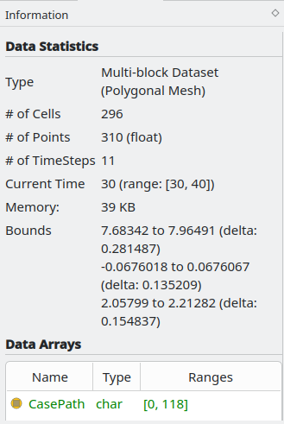
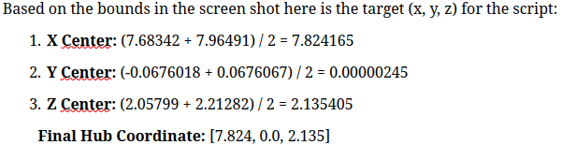
Finding the Coordinate at the blade center
First, we open a single snapshot and isolate the Nacelle so instead of loading everything we just go into sauna properties panel and select only FOWT_nacelle. Next look at the "Data Statistics" panel and here we will see the ranges (bounds) for X, Y and Z. We get the midpoint of the bounds here:

Slide 4
The Probe
Now we have the (x, y, z) coordinate being (7.824, 0.000, 2.135) 3 D.P we need to tell ParaView to look at the wind at that specific point. First go back to the properties panel and apply only "internalMesh" and "U". Then go into the filters section, alphabetical, and look for the Probe Location option. In the properties for the Probe simply enter the center coordinates from before aka (7.824, 0.000, 2.135) and click apply. It will then show a value of U in 3 components of U aka Ux, Uy, Uz. This is the specific air data hitting the turbine. NOTE since the nacelle is modeled as a physical void in the internalmesh we move the probe X value from 7.824 to 7.5, this puts the measurement a few centimeters in from of the rotor so its catching the air as it hits the blades otherwise the U values we would get would be 0. The U values at time 30 are –0.925, 1.322, 0.137.

Slide 5
Making the Extraction Script
Since doing this for each snapshot present and maybe in the future would be tedious and time consuming, we have a script that will automatically look at the 10 snapshots and extract the winds speed as well as the platform tilt from the metal in one go. This script is named "Full Extraction Script" in the files.
One final check is the direction of the wind, since in the data we can see that the Ux value is negative we know the wind is blowing backward, in Unity we will have to make sure the turbine is rotated to face this wind. In simpler terms in Unity we must make sure it is blowing from the positive x direction to the negative x direction. (speed value for blades must be set to negative).

Slide 6
The FOWT_platform aka "the boat"
This is the part that sits in the water and acts as a sort of ship, in the data it is what moves when you look at pointdisplacement. In Unity it would be a parent object, when it tilts it will also tilt the whole turbine.
In Unity to simulate this turbine properly it won't be static, in the animation it will show the platform bobbing up and down (using heave data) and tilting back as the wind pushes it (using pitch data).

Slide 7
Process of transferring it over to unity
The Unity C# Script is designed to act as a bridge between the CFD data and the 3D model, it will read the Unity_FOWT_Data.csv file, handle the coordinate system swap and use linear interpolation to make the 10 snapshots look smooth.
Command to run the script is:
pvpython extract_fowt.py
Then once the file is acquired
Go to Installs -> Install Editor
Choose the latest LTS (Long Term Support) version
Ensure the Linux Build Support (Mono) module is selected

